Slide 1
Communication Establishing a Common ground

Slide 2
B.E 1st Year
CSE-A , ECE-F, EEE
Academic year 2021-22
Dr.T. SUNAND EMMANUEL

Slide 3
Communication and Health
Closely linked to physical and psychological health. (Dean Ornish)
Humans have a basic need to interact with others and feel that they belong in communities.
After years of studying healthy and sick people, …satisfying interactions and relationships

Slide 4
“Love and intimacy are at the root of what makes us sick and what makes us well. More than medicine, diet, smoking, exercise—that has a greater impact”

Slide 5
“Constantly talking isn't necessarily communicating.”
Life is made up, not of great sacrifices or duties, but of little things, in which smiles and kindness, and small obligations given habitually, are what preserve the heart and secure comfort. Humphry Davy

Slide 6
“You can talk with someone for years, everyday, and still, it won't mean as much as what you can have when you sit in front of someone, not saying a word, yet you feel that person with your heart, you feel like you have known the person for forever.... connections are made with the heart, not the tongue.”

Slide 7
“Oh the comfort, the inexpressible comfort of feeling safe with a person, having neither to weigh thoughts nor measure words, but pouring them all right out, just as they are -- chaff and grain together -- certain that a faithful hand will take and sift them, keep what is worth keeping, and with the breath of kindness blow the rest away.” ―

Slide 8
Assumptions are the termites of relationships.
“Don't use words too big for the subject. Don't say infinitely when you mean very; otherwise you'll have no word left when you want to talk about something really infinite.”
“The single biggest problem with communication is the illusion that it has taken place.” ― George Bernard Shaw

Slide 9
“Constantly talking isn't necessarily communicating.”
Life is made up, not of great sacrifices or duties, but of little things, in which smiles and kindness, and small obligations given habitually, are what preserve the heart and secure comfort. Humphry Davy

Slide 10
Definitions
An exchange of facts, ideas, opinions or emotions by two or more persons.( W.H. Newman and C.F. Summer Jr.)
Process by which information is transmitted between individuals and/or organizations so that an understanding response results. (Peter Little)
Process of establishing a common ground between two people.

Slide 11
Process by which information and feelings are shared by people through an exchange of verbal and nonverbal messages.
An interactive, ongoing process in which common ground (beliefs, knowledge, experiences) is accumulated and updated

Slide 12
Communication is the sum of all things one person does when he wants to create an understanding in the mind of another. It involves a systematic and continuous process of telling, listening and understanding. (Allen Louis)

Slide 13
Administrative communication is a process which involves the transmission and accurate replication of ideas ensured by feedback for the purpose of eliciting actions which will accomplish organizational goals” (William Scott )
A process of meaningful interaction among human beings.(Mc Farland)

Slide 14
A purposeful exchange of facts, ideas, opinions, emotions and information that leads to a common understanding.
The ability of one person to make contact with another and to make himself or herself understood. (John Adair)

Slide 15
The process by which people seek to share meaning via the transmission of symbolic messages. (F.E.X. Dance ‘The Concept of Communication’)
A personal process that involves exchange of behaviours .(Fred Luthans)

Slide 16
The process of acting upon information. Somebody said or did something, and the other person responds to it.
Communication is a systemic process in which people interact with and through symbols to create and interpret meanings. (Wood)

Slide 17
Indian Perspective of communication
Sadharinikaran –simplification of meaning
And this Sadharinikaran takes place among sahridiyas (same heart, mind, soul)

Slide 18
Linear/transmission model of communication
SPEAKER
LISTENER

Slide 19
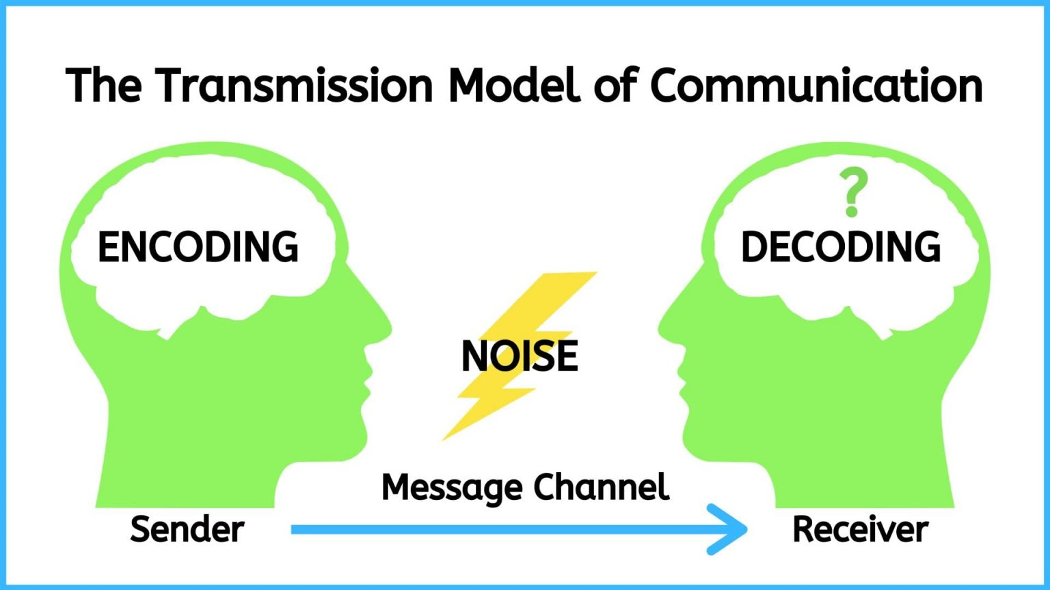
Transmission model of communication

Slide 20
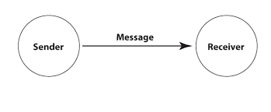

Slide 21
INTERACTIVE Model (Wilbur Schramm)
FEEDBACK
SPEAKER
LISTENER

Slide 22
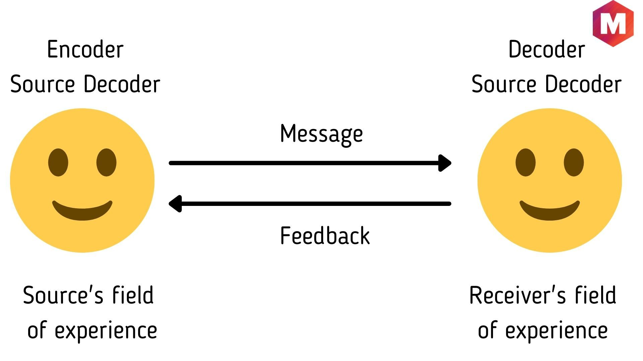
Interactive model of communication

Slide 23
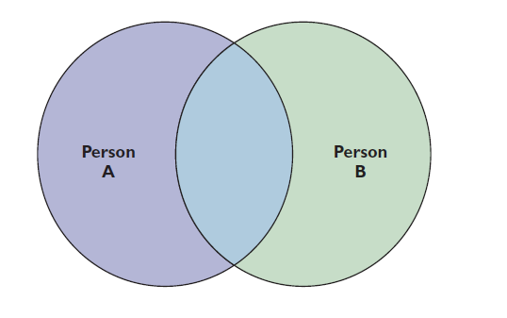
Shared experiences

Slide 24
Transactional Model (David Barnlund)
FEEDBACK… TIME
SPEAKER
SIMULTANEOUS
LISTENER
SIMULTANEOUS

Slide 25
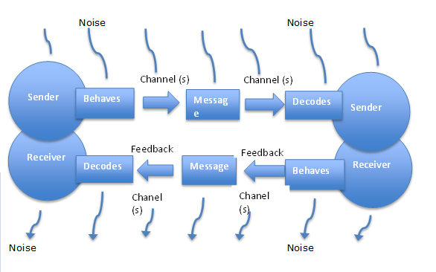
TRANSACTIONAL MODEL

Slide 26
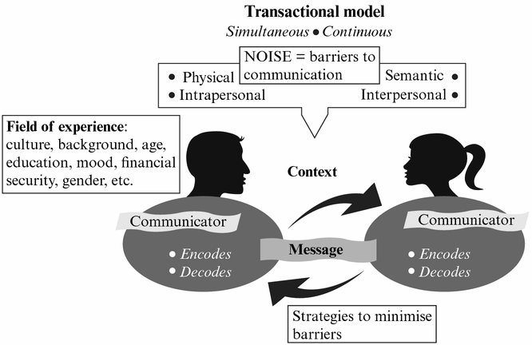

Slide 27
Lasswell’s 5 Questions
Who?
Says what?
In what channel?
To whom?
With what effect?

Slide 28
Barnlund’s 6 persons
What does John think of himself?
What does John think of Ravi?
What does John think of what Ravi thinks of him?
What does Ravi think of himself?
What does Ravi think of John?
What does Ravi think of what John thinks of him?

Slide 29
Barriers
Types of barriers
Physical barriers
Semantic
Socio-psychological

Slide 30
Physical barriers
Noise
Traffic noise
Faulty equipment
Bad spelling
Poor handwriting

Slide 31
Physiological
Ill health
Headache
Fever
Any physical uneasiness

Slide 32
Semantic
Denotations--- table, chair (literal/dictionary meaning)
Connotation--- honesty, good, fair, sincere, sincere…. (figurative/everyone has a personal/subjective meaning)

Slide 33
Socio-psychological
Abstracting--- focussing on some details and omitting others
Allness fallacy--- Whatever is know is all that needs to be known
Slanting--- We are aware of other aspects, but we deliberately ignore what does not suit us.

Slide 34
Some other barriers
Lack of planning
Cultural barriers
Filtering
Information overload
Poor retention
Poor vocabulary
Goal conflicts
Offensive style
Time and distance
Transmission problems
Narrow mindedness
Language barrier
Poor listening
Unclarified assumptions
Inferiority complex
Superiority complex

Slide 35
Barriers to communication
Hurried conclusions
Jumping the gun
Highly emotional
Technical jargon
Fear of superiors
Using wrong channel
Personal likes and dislikes
Low self-esteem
Status conscious
Homonyms (Object as a noun and verb)
Self-centeredness
Stubborn
defensiveness

Slide 36
The 7Cs of communication
Completeness
Conciseness
Considerateness
Concreteness
Clarity
Courtesy
Correctness

Slide 37
Completeness
Have all the facts ready
What, when, where, how, who, why
Time, date, venue, setting.
Give additional information if needed
If you cannot answer, say so politely.
Promise to get back
Provide all information ready

Slide 38
Conciseness
Avoid lengthy phrases
Eliminate wordy expressions
At this point in time… ( now)
Due to the fact that …. (because)
In due course … (soon)
Don’t overuse ADJECTIVES

Slide 39
Considerate
Prepare the message with the receiver in mind
Put yourself in the receiver’s shoes, Empathy, Human touch
You are completely off base in your proposal.(Rude)
We have different interpretations of the utility of the proposal. (better)
The proposal has 3 aspects which need clarification (better)

Slide 40
Concreteness
Be specific, definite, vivid
Use specific facts and figures if needed
Put action in verbs
It is shown by figures (Figures show)
A decision has been made by the Dean (the Dean has made the decision)
Prof. John will give consideration to the report. (Prof. John will consider the report)

Slide 41
Clarity
Use precise, concrete, familiar words
Expand abbreviations (don’t assume)
Use 17-20 words in a sentence
3-30 words also okay
Put main ideas first.
Mixture of complex and simple sentences.

Slide 42
Courtesy
Be polite and respectful of others
Gender, age, color, region, religion, race, caste, community, sexual orientation
Use expressions that show respect
Wait for your chance to speak
Politeness begets politeness
Thank generously

Slide 43
Apologize for intentional and un intentional mistakes
Answer promptly within 24 hours
Acknowledge if there is delay
Empathize

Slide 44
Correctness
Proper grammar, punctuation, spelling
Check accuracy of facts, figures
Avoid slang (ain’t … is not)
Ask another person to check your draft for feedback
Timeliness is useful
Be sure of the correctness of the information

Slide 45
10 commandments of American Management Association
Seek to clarify ideas before communicating
Examine the true purpose
Consider the total, physical, human setting
Consult with others, where appropriate in planning communication
Be mindful of overtones as well as basic content of message

Slide 46
6. Take opportunity when it arises to convey something of help or value to the receiver
Follow up your communication
Communicate for tomorrow as well as for today
Be sure your actions support your communication
Seek not only to be understood, but also to understand.

Slide 47
Other features
Attentiveness while talking and listening
Objectivity – don’t be emotional, prejudiced, partial.
Use grapevine strategically
Feedback: Ask questions, take feedback, ask for improvements, 2-way communication.
Body language (posture, gesture, eye contact, polite, considerate tone)

Slide 48
Elimination of noise– try to reduce physical and psychological noise
Synergy– create Synergetic environment of trust, cooperation. Open cooperation.
Institution is greater than individual
Strengthen communication flow
Proper media (face to face, phone, email, fax, letters, whatsapp, twitter, facebook, )

Slide 49
Encourage open communication
Have an open door policy
MBWA (Management By Walking Around)
Do subordinates approach you to discuss their problems?

Slide 50
This PPT is dedicated to my teachers......
Prof. Mark L. Knapp
Prof. Brian H. Spitzberg
Prof. Joseph A DeVito

Slide 51
Thank you

